Slide 1
SPDC Wellhead Sabotage Reduction
Report-out to Sponsors

Slide 2
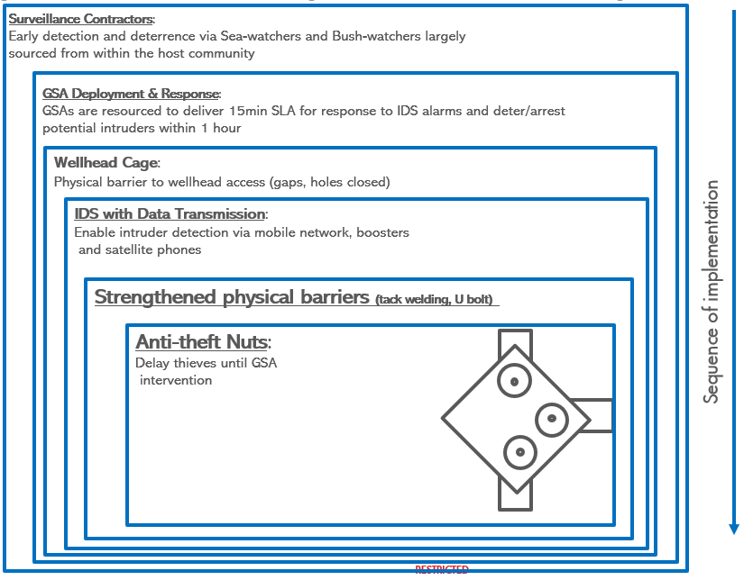
Previously Agreed: Asset owns all well head cages Project Ops Mgrs (POMs) to drive integrated delivery of existing cage improvements/modifications & new well head cages installation; collaborating with other functions as required. Appoint Security Resilience Manager to drive integrated delivery in operate and maintain phase of WH cages; Contract Holder and Owner remain within Security function Move 2023 CAPEX Budget from WRFM to Security to strengthen ownership IT enlisted as core function during planning and installation of WH Cages
Recap:
Layered, risk-based approach (strengthening barriers)

Slide 3
GET VALUE FROM INSTALLED CAGES
# | Action | Intended Outcome | Action Owner | Budget Required | Status | Complete by
1 | Provide fit for purpose booster IT networks to cover wellhead locations + NIN registrations | Receive all WH intrusion alerts on configured phone lines | IDT Portfolio Mgr. - SK | F$110K | Ongoing – Satellite phone (Thuraya) excluding CCTV | Q2 2023
2 | Install anti-theft nuts on all caged wells flanged connections prioritized by risk | Restore 1st barrier in layers of protection. | CWI Mgr. – Timothy | TBA – revised number | Open - LLI | Q3 2023
3 | Review and strengthen surveillance in Tunu Node: Bush & Sea Watchers | Restore 2nd barrier in layers of protection. | GM Security - Ed | NA | Ongoing
4 | GSAs resourced (MPVs fuelled etc) and support maintaining 15 minutes notice to respond | Deter/arrest intruders | Security Resilience Mgr - Ed | NA | Ongoing | Oct- 22
5 | Replace missing gratings on all well heads & bolt-up/tack weld identified gratings on swamp wellhead platforms | To prevent access from below the cages | OABP Project Lead - Okey | TBA | Ongoing | Q3 2023
6 | Review the design of the current cages | To ensure cages are more self protective from phased vandalism | Security Resilience Mgr - Ed | To be advised | Open | TBA

Slide 4
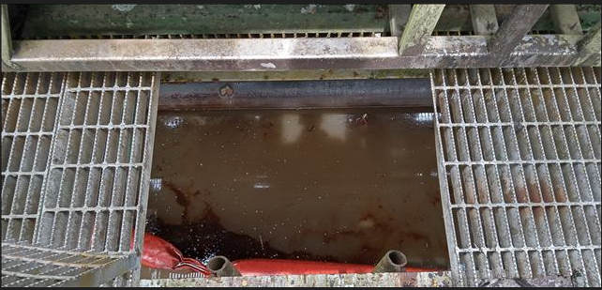
Barrier Strengthening - Priority 1 Activities
West Asset
Central & East Asset
 |  | Cage Strengthening (Doors, Close Gaps, padlocks) | Secure Gratings (Tack Weld or Bolting) | Anti-theft Nuts Required | Satellite Phones or Boosters
Priority 1 | Opukushi | 15 | - | 15 | 8
 | Tunu | 2 | - | 5 | 1
 | Benesede | 6 | 3
 | Ogbotobo | 1 | - | 2
 |  | 24 | 3 | 22 | 9
 |  | Cage Strengthening (Doors, Close Gaps, padlocks) | Secure Gratings (Tack Weld or Bolting) | Anti-theft Nuts Required | Satellite Phones or Boosters
Priority 1 | Soku | 7 |  | 4 | 5
 | Etelebou | 4 |  | 4
 | Adibawa | 2 |  | 6
 | Ubie | 1 |  | 3
 | Ahia/Minita | 3
 | Obelle | 1 |  | 3
 | Gbaran | 4 |  | 3
 | Kolo Creek | 3 |  | 3
 | NR/D |  |  | 4
 | Oguta |  |  | 3
 |  | 25 | - | 33 | 5
*Remaining West vulnerability assessment currently work in progress (26 Thuraya required)

Slide 5
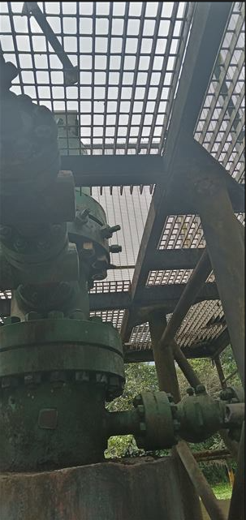
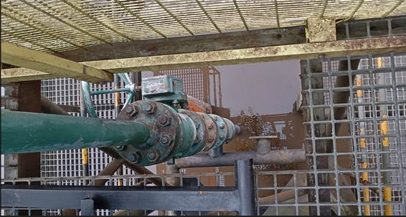
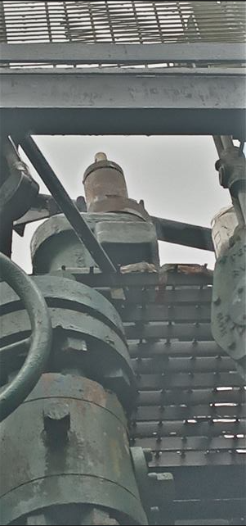
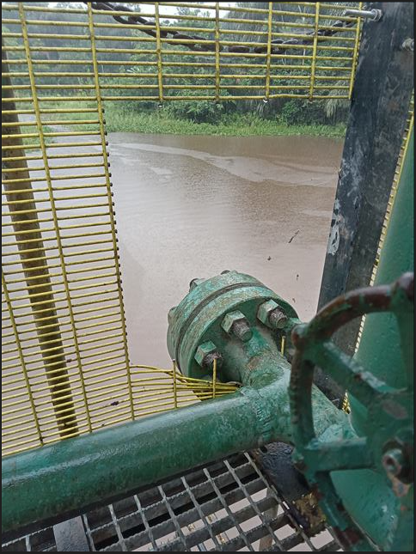
West Asset
Barrier Strengthening - Priority 2 & 3 Activities
Central & East Asset
 |  | Cage Strengthening (Doors, Close Gaps, padlocks) | Secure Gratings (Tack Weld or Bolting) | Anti-theft Nuts Required | Satellite Phones or Boosters
 | Priority 2 | 16 | 2 | 13 | 4
 | Priority 3 | 25 | 6 | 27 | 3
 |  | Cage Strengthening (Doors, Close Gaps, padlocks) | Secure Gratings (Tack Weld or Bolting) | Anti-theft Nuts Required | Satellite Phones or Boosters
 | Priority 2 | 40 | 0 | 12
 | Priority 3 | 7 | 0 | 2

Slide 6
Barrier Strengthening Sequence (Integration)
 |  | Oct 22 | Nov 22 | Dec 22 | Jan 23 | Feb 23 | Mar 23 | Apr 23 | May 23 | Jun 23 | Jul 23 | Aug 23
Surv | Bush Sea Watcher bedding In
 | B & S review
 | B + S Plus Model TBC
Communications | 47 Well Head Cages fitted with Thuraya Tech
 | GSM Boost
 | Voice-over radio Link – CCTV compatible
 | PIR
Response | GSA Commandeer Commitment to maintain 15NTM
 | MPV refueled 24/7
Upgrades | Tunu Anti Theft Nuts installation (Using embedded CWI teams)
 | Cage Strengthening (doors, locks, Tack welding, U-Bolting, etc)
Design | Design Review
Priority 1 (w)
Priority 1(E) &2
Priority 2 & 3
Further Evaluation
Priority 1
Priority 2

Slide 7
Support Required
PROTECT VALUE BY INSTALLING NEW WH CAGES
2023: Install new cages based on priority shown below to protect 27 Kbopd from 42 oil wells & 116.7mm SCF/d from 2 gas wells in areas with effective signals only (44 cages identified).
Beyond 2023: Integrate WH cages with new wells delivery; Security sustains overall effectiveness of WH cages under BMM structure/2nd Level Maintenance support contract with OEM
Approval for the additional budget to address improvement actions viz:
2022 Scope : Potential Well Head Cage underspend cira 1.6m OP21 of FSD 5.6 budget. Propose F$110k expenditure for 47 Satellite phones, etc offset from underspend
2023 Scope : Allocated OP22 budget F$4.9 mln to be reduced to FS2.7mln and remainder (2.2 mln) reassigned to other priority areas
Approval to continue with installation of prioritized additional 44 cages in 2023 and operate & maintain
Approval to progress upgrade plan as proposed
Priority | Description | Qty | Location
1 | High vandalism risk | 21 | Soku & Diebu Creek
2 | New Wells/AF/ STOG Wells | 21 | East/West Asset
3 | Gas Wells | 2 | West Asset
Notes:
Enlist resource from IT SOM as core function during planning and installation of WH Cages.
Strong network coverage is necessary for overall effective WH cages intrusion detection and response strategy
Optimising ROI on the current cages: This is where we should have the things we are doing to make the current cages secure and effective with cost and timelines where applicable – IT/signal optimisation, Surveilance contracts updates, GSA reorganization,secure gratings, antitheft nuts, etc.
Proposed additional cages in selected areas (refers to your 65 but in addition to the current description Must include additional WH cage selection criteria -e.g High value wells, areas with optimum signal strength, etc.) Also a statement on the timing – to be commenced after we have improved the efficacy of the current cages so we are transferring learning to the new cages.
Budget proposals: This is really an outcome of 1&2 above.
Governance: a slide on the movement of BOM role to Security function.

Slide 8
Back-up Slides
BT Nongo

Slide 9
Steers from first debrief with sponsor
Prioritise the big things that are really going to make a difference, be clear on the intended outcome on those and convince yourself that they can be achieved in a 2-3 months timeframe with the right support. I heard:
1. Putting the right signals boosters in place,
2. solving the surveillance vs intelligence problem in the West and
3. Raise GSA ‘alertness’ and change-out, as the top 3, but you might want to relook at this as a team.
It’s important that this group all believes we are addressing what needs to be addressed.
Each items to be clearly articulated on what it is that is going to be done, what it is meant to achieve and how we would know that we’re ‘there’.
Propose the right organisational set-up, BOM or otherwise, to drive integration for all the aspects you have uncovered as a team. Align around it as a team so that you really know it will work when we put it into practice and that we have the required commitment from individual departments to work it in an integrated fashion.
The steer on budget is secondary: Intuitively I don’t see why we would spend more money, if we can spend some of the existing/planned budget on the above/things that really matter. So yes, I do want to see a better return on the money we have already spent. I do ALSO still want to extend the nr of cages , but if I have to sacrifice a bit of that against getting the ones we have to work, then let’s do that (e.g. addressing these bolts that we apparently should have been using, but aren’t, tack-welding gratings, signal boosters (although I think we’ve already budgeted for those in our portfolio capex), etc..

